Slide 1


Experiential Learning
Project Assessment-I on
“Balanced Parenthesis Checker”
under the course
Python Programming Language (N-PCCCM304P)
Presented By Swanandi Kshirsagar CM25116
Under the Guidance of
Mrs. Mayuri Getme
Session: 2026-27 (ODD)
Department of CSE (AI&ML)
S. B. JAIN INSTITUTE OF TECHNOLOGY MANAGEMENT AND RESEARCH, NAGPUR

Slide 2
Phase 1 - Contents
Problem Statement
Objectives
Algorithm
Flowchart / Pseudocode
Understanding of Python Logic
Graph Representation and Working
GitHub Account, Repository Creation and Code Upload
Meaninsgful Commits, Collaboration and Individual Contribution
Result / Expected Output

Slide 3
Phase 1 - Problem Statement
Mathematical expressions and programming code often contain
parentheses, brackets, and braces.
Incorrect placement or ordering of these symbols can make an expression invalid.
The project checks whether every opening symbol has a corresponding
closing symbol.
It verifies the symbols in the correct order using a stack-based approach.
The system accepts an expression as input and displays whether it is Balanced or Not Balanced.

Slide 4
Phase 1 - Objectives
Represent users as vertices and friendships as edges.
Store the network using an adjacency-list structure.
Add users and create friendship connections.
Find mutual friends between users.
Recommend friends-of-friends based on mutual connection count.
Use BFS to demonstrate graph traversal through the network.

Slide 5
Phase 1 - Algorithm
Friend Recommendation + BFS Traversal
Input the target user.
Get the user's direct friends from the adjacency list.
Visit each direct friend's connections.
Ignore the target user and existing direct friends.
Count mutual connections for each candidate.
Sort candidates by mutual-friend count in descending order.
Display recommended friends.
Use BFS to traverse the network level by level.

Slide 6
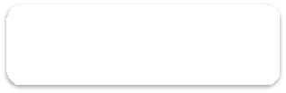
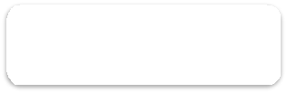







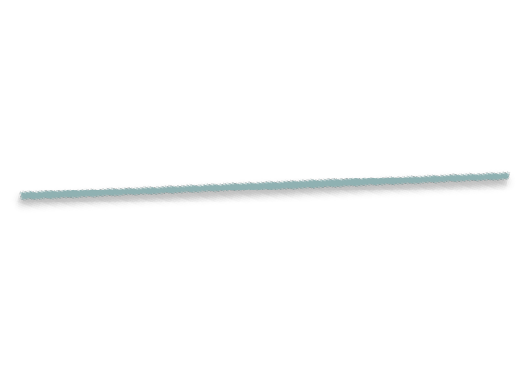
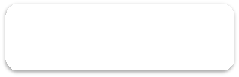
Phase 1 - Flowchart / Pseudocode
START
Enter Expression
Create Empty Stack
Is it an Opening Symbol?
→ YES: Push into Stack
→ NO: Check Closing Symbol
Read Each Symbol
Does it Match Stack Top?
→ YES: Pop from Stack
→ NO: Not Balanced
Are All Symbols Checked?
Display Result
Display Result

Slide 7
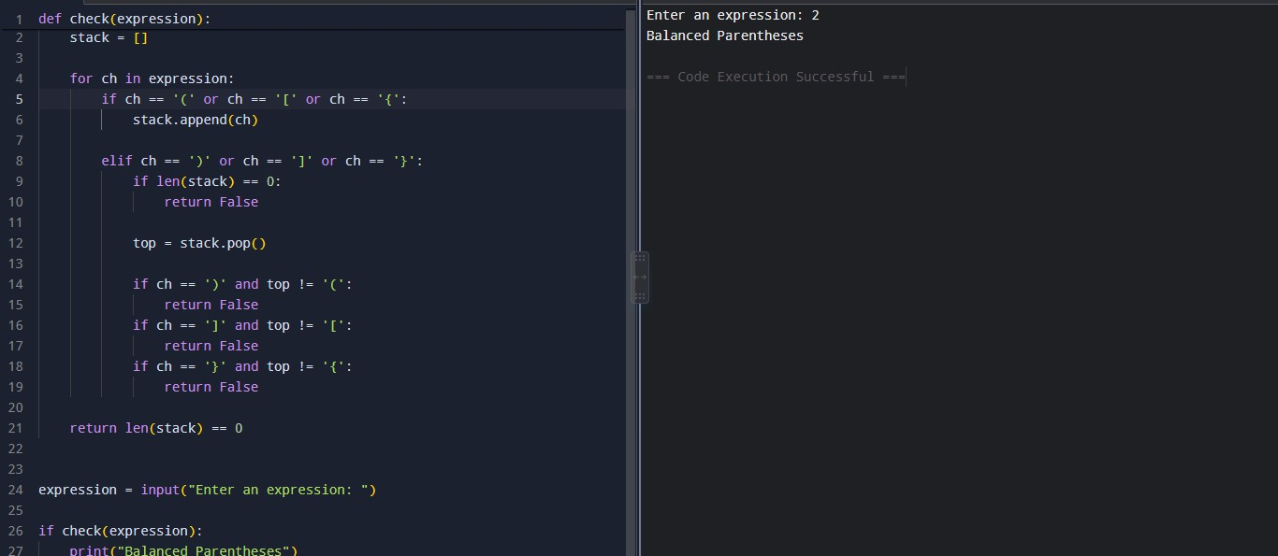
Phase 1 - Understanding of Python Logic
Python concepts: dictionary • set • intersection • loops • sorting • deque/BFS

Slide 8

Phase 1 - Graph Representation and Working
Expression:
{[()]}
Stack Working:
{ → Push { [ → Push [ ( → Push (
) → Match ( → Pop
] → Match [ → Pop
} → Match { → Pop
Final Stack: Empty Result: Balanced Key Concepts:
Opening symbol → Push
Closing symbol → Match + Pop
Wrong match → Not Balanced
Empty stack at end → Balanced

Slide 9

Phase 1 - GitHub Account, Repository & Collaboration
Create / use a GitHub account for the project.
Create a repository: Balanced-Parenthesis-Checker
Upload the Python program and README.md.
Use meaningful commits such as:
Initial Python code Stack implementation Parenthesis matching Test cases Documentation
Use repository sharing or branches for collaboration.
Keep individual contribution visible through commits and documentation.
Balanced-Parenthesis-Checker
│
├── main.py
├── README.md
└── screenshots/

Slide 10
Phase 1 - Individual Contribution
Designed the logic for checking balanced parentheses.
Implemented the stack-based approach in Python.
Implemented matching of (), [], and {}.
Tested the program using balanced and unbalanced expressions.
Handled incorrect ordering and missing brackets.
Prepared documentation, presentation and GitHub repository.

Slide 11
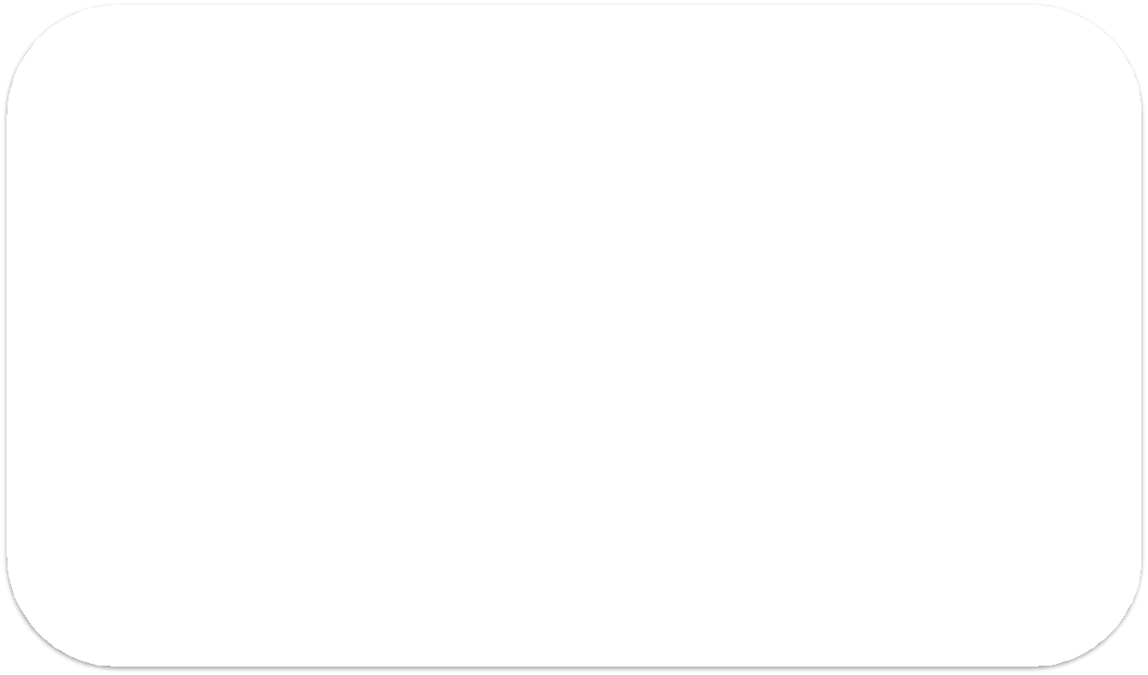
Phase 1 - Result / Expected Output
Input:
Enter an expression: {[()]}
Output:
Balanced Parentheses
Input:
Enter an expression: {[(])}
Output:
Not Balanced Parentheses
The system recommends users with stronger mutual connections first.

Slide 12
Phase 2: Graph Representation
Graph Representation and Working
Content:
Represent users as vertices (nodes).
Represent friendships as edges.
Store the network using an Adjacency List.
Add users and create friendship connections.
Graph helps us understand connections between users.

Slide 13
Phase 2 - Friend Recommendation Algorithm
Algorithm
Input the target user.
Find the user's direct friends.
Check connections of each direct friend.
Ignore existing friends and the target user.
Count mutual connections.
Sort candidates by mutual-friend count.
Display recommended friends.

Slide 14
Phase 2 - Python Logic & Result
Python Logic
Dictionary → store the graph
Set → store unique friends
Intersection → find mutual friends
Sorting → rank recommendations
Deque → implement BFS

Slide 15
Phase 2 - Flowchart: Friend Recommendation
START
↓
Enter Target User
↓
Get Direct Friends
↓
Check Friends of Friends
↓
Count Mutual Friends
↓
Sort Recommendations
↓
Display Recommendations
↓
END

Slide 16
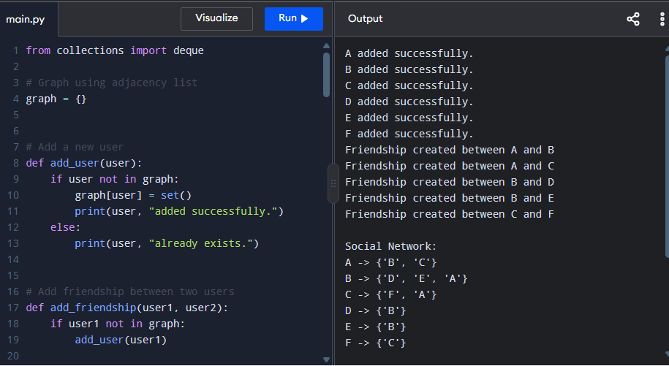
Phase 2 - Result / Expected Output

Slide 17
GitHub: Phase II Development & Contribution
GitHub Repository
Phase II Commit
Added Python implementation Implemented parenthesis matching
Added test cases Updated documentation
Balanced-Parenthesis-Checker
Python project repository
main.py
README.md
Screenshots / documentation
Phase II Progress✓ Implemented stack-based approach
✓ Matching of (), [], {}
✓ Checked correct ordering
✓ Tested balanced and unbalanced expressions
✓ Handled missing/wrong brackets

Slide 18
Phase 3 - Problem Statement
Brackets must open and close in the correct order. In deeply nested expressions, checking them manually can be error-prone.
The Challenge
Detect missing, extra, or incorrectly ordered brackets.
Bracket Types
Round brackets: ( )
Square brackets: [ ]
Curly brackets:
The Solution
A Python checker uses a stack and displays a clear result on a web page.
Project Aim
Build a simple, reliable bracket validator and connect it to a browser interface using Flask.
Example:
{a + [b * (c + d)]} → Correctly nested

Slide 19
Phase 2 - Objectives
Implement a stack-based bracket checker.
Understand the Last In, First Out (LIFO) principle.
Detect extra, unmatched, and mismatched brackets.
Connect Python logic to a web interface using Flask.
Display clear validation results for user input.

Slide 20
Phase 3 - Algorithm
Start and read the expression.
Create an empty stack and bracket-pair mapping.
Traverse the expression from left to right.
Push every opening bracket onto the stack.
For a closing bracket, check whether the stack is empty.
Compare it with the opening bracket at the top of the stack.
If matched, pop it; if not, return False.
At the end, an empty stack means Balanced; otherwise, Not Balanced.

Slide 21
Phase 3 - Flowchart
START
↓
Input expression
↓
Initialize empty stack
↓
Read next character
↓
Is it an opening bracket?
YES → Push onto stack.
NO → Check whether it is a closing bracket.
↓
Is the stack empty or is the top bracket incorrect?
YES → Not Balanced.
NO / MATCH → Pop the stack.
↓
Are there more characters?
YES → Read the next character.
NO → Check whether the stack is empty.
↓
Stack empty → Balanced
Stack not empty → Not Balanced

Slide 22
Phase 3 - Understanding of Python Logic
def is_balanced(expression):
stack = []
pairs = {')': '(', ']': '[', '}': '{'}
for char in expression:
if char in '([{':
stack.append(char)
elif char in ')]}':
if not stack:
return False
if stack[-1] != pairs[char]:
return False
stack.pop()
return len(stack) == 0

Slide 23
Phase 3 - Understanding of Python Logic
def is_balanced(expression):
stack = []
pairs = {')': '(', ']': '[', '}': '{'}
for char in expression:
if char in '([{':
stack.append(char)
elif char in ')]}':
if not stack:
return False
if stack[-1] != pairs[char]:
return False
stack.pop()
return len(stack) == 0

Slide 24
Phase 3 - Tools, GitHub & Deployment
1. Python 3
Implements expression traversal, stack operations, and matching logic.
2. Flask + HTML
Connects the checker function to a browser-based form.
3. Git + GitHub
Tracks code changes and makes project files shareable.
Live Deployment (as listed in the report)
https://pythonprogramming-templates.vercel.app/
Github link
https://github.com/swanandikml25-pixel/my

Slide 25
Phase 3 - Conclusion
A Practical Use of the Stack Data Structure
The project checks whether round, square, and curly brackets are correctly matched and nested.
A Python list implements the stack, while Flask and HTML provide a simple browser interface.
Key Learning
LIFO • Stack Operations • Python Logic • Flask Integration • Testing

Slide 26
Thank You
Balanced Parenthesis Checker

